Slide 1
COMP 3500 Introduction to Operating Systems The Highest-Paying College Majors
Dr. Xiao Qin
Auburn University http://www.eng.auburn.edu/~xqin
xqin@auburn.edu
Notes:
http://www.cnbc.com/2016/10/19/the-50-highest-paying-college-majors.html

Slide 2
2013 vs 2016
13 November 2017
Notes:
2
We will start with the question of our job market.

Slide 3
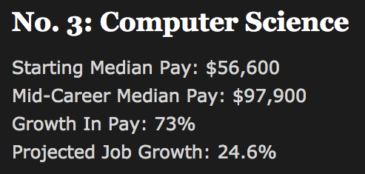

Notes:
2013

Slide 4
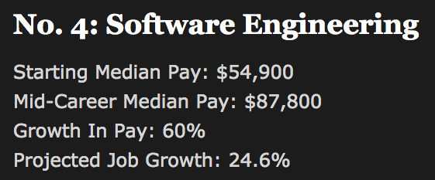
Notes:
2013

Slide 5
Photo: Getty Images
Notes:
Reference:
2016:
http://www.cnbc.com/2016/10/19/the-50-highest-paying-college-majors.html
http://www.cnbc.com/2016/10/20/the-top-10-skills-that-will-get-you-hired.html

Slide 6
COMP 3500 Introduction to Operating Systems The top 10 skills that will get you hired
Dr. Xiao Qin
Auburn University http://www.eng.auburn.edu/~xqin
xqin@auburn.edu
Notes:
From LinkedIn
http://www.cnbc.com/2016/10/20/the-top-10-skills-that-will-get-you-hired.html

Slide 7
Notes:
If you can write Java code, you're in high demand.
Java developers work on the code for games, software and mobile applications and internet programs. They usually hold a bachelor's degree in computer science or a related field and earn about $71,000 per year, according to PayScale.

Slide 8
Notes:
Algorithm design is about creating the software commands that are at the heart of computer science.
Most job descriptions related to algorithm design require a degree in electrical engineering, computer engineering or computer science, according to Glassdoor postings.
Relevant jobs pay $72,000 to $136,000, recent job postings show.

Slide 9
Notes:
Web architecture is the art of designing the technical, aesthetic and functional layout of websites. Web architects make an average of $98,000 per year, according to Glassdoor.
Recommended degrees to get this skill include computer programming, computer science or related subjects, according to recent job postings.

Slide 10
13 November 2017
Notes:
10
This skill involves working with middleware, or the software that "glues together" separate, often complicated computer programs.
Relevant jobs include software engineer, with an average salary of $70,000, and information technology manager, with an average salary of $117,000, among other higher level positions.

Slide 11
Notes:
Big and small companies alike need people who can investigate and protect information stored on their computer networks.
Related jobs include security architect ($119,000) and security IT consultant ($82,000).

Slide 12
Notes:
User interface design is all about making an application or program usable for customers. Products are increasingly data-driven, which means that employers need people who can make it easy for customers to interact with their products, the report notes.
User interface design has become a more important skill over the past few years. It didn't make 2014's list, came in at No. 7 last year, and jumped two spaces to No. 5 this year.
These technical designers make an average of $96,000, according to

Slide 13
Notes:
This skill is about making sure information systems and networks stay organized and run smoothly.
Jobs include a systems administrator ($61,000), storage engineer ($86,000) and senior storage engineer, ($101,000).

Slide 14
Notes:
IPhone and Android software and apps don't magically appear. Mobile developers build everything that makes you love and depend on your smartphone.
Mobile applications developers make a median of $72,000.

Slide 15
Notes:
Data sets provide treasure troves of information for all types of companies. If you can sift through and analyze data, you'll be able to take your pick of positions. Data scientists make a median of $93,000.

Slide 16
Notes:
Managing, organizing and distributing hosted services over the cloud is this year's most sought-after skill, according to LinkedIn. It was also the top skill in 2015.
Google, Microsoft, and Amazon are all looking for employees with this training, and these jobs offer $95,000 and $131,000, according to Payscale.

